Slide 1
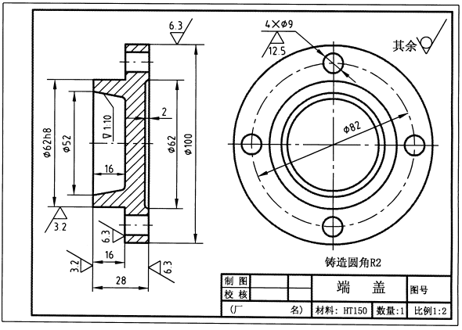
A mechanical dimensional engineering drawing looks like this

Slide 2
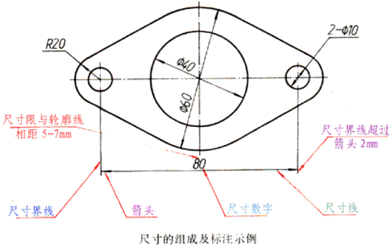
Engineering drawing dimension style

Slide 3
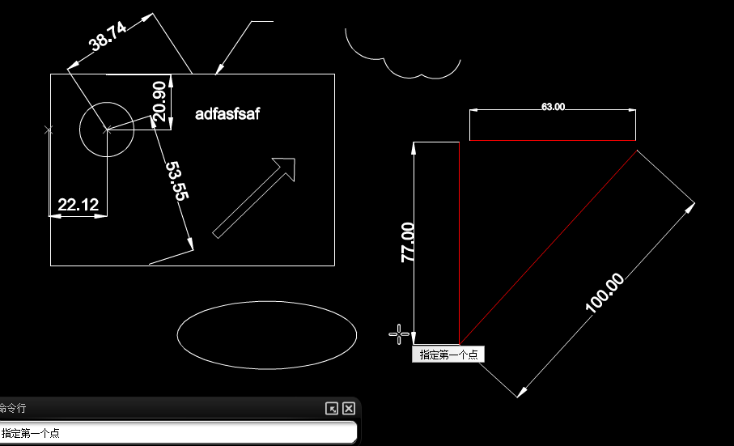
AutoCAD WS looks like this

Slide 4
Rena will look like this

